Slide 1
ALC(auto level control)
G.169 relates to network-based Automatic Level Control (ALC) devices. An ALC device is defined as any signal processing function located in the digital transmission path which automatically adjusts the level of a signal towards a pre-determined value.
Our goal: put the signal level in specified control range. Avoiding voice signal too big or too small.

Slide 2

Simple control
Power up, microphone gain down
Power down, microphone gain up.
Signal power Base on RMS (root mean square) value

Slide 3
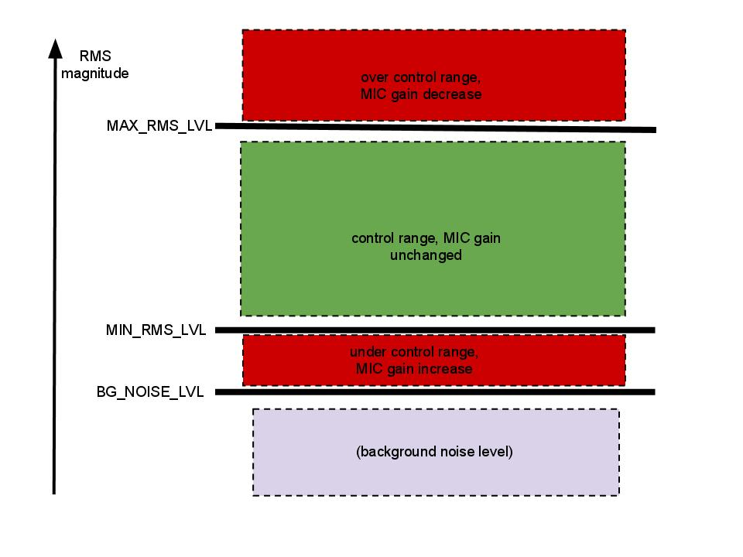
-12dB, 80ms
-30dB, 160ms
-40dB, 160ms

Slide 4
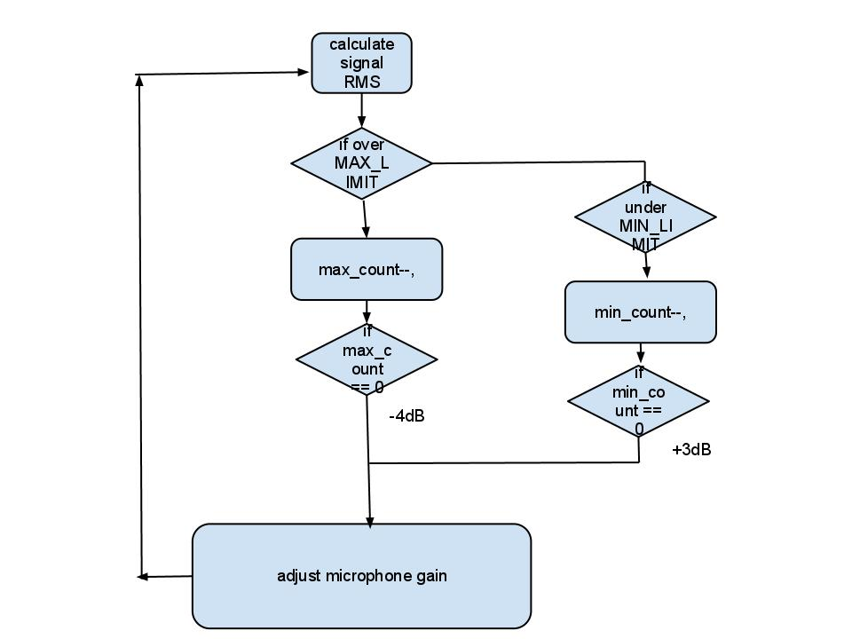
Auto Level Control

Slide 5
demo

